Slide 1
Financial Analytics Report
Analysis of Market Capitalization and Quarterly Sales

Slide 2
Introduction
Objective:
To analyze the financial performance of companies based on market capitalization and quarterly sales.
Data Source:
CSV dataset containing financial data of 488 companies.
Key Metrics:
Market Capitalization (in Cr)
Quarterly Sales (in Cr)
Sales Efficiency Ratio
Slide 3: Data Overview
Summary of the Dataset:
Number of records: 488
Columns analyzed: Market Cap, Quarterly Sales
Initial Observations:
Missing values in Market Cap and Quarterly Sales columns.
Anomalies in serial numbers indicating missing entries.

Slide 3
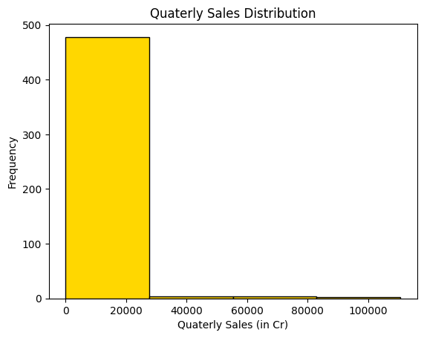
Market Cap Distribution
Majority of companies fall within a specific market cap range.
Distribution skewed towards companies with lower market cap.
Histogram plot for Quarterly Sales Distribution
Most companies have quarterly sales within the lower range.
Few companies with exceptionally high sales.

Slide 4
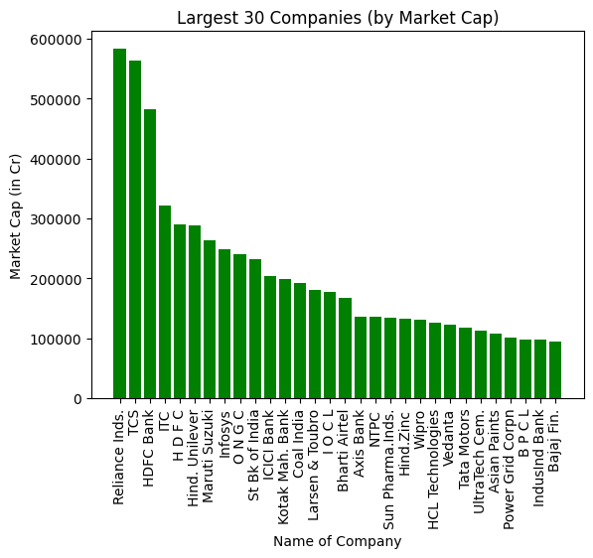
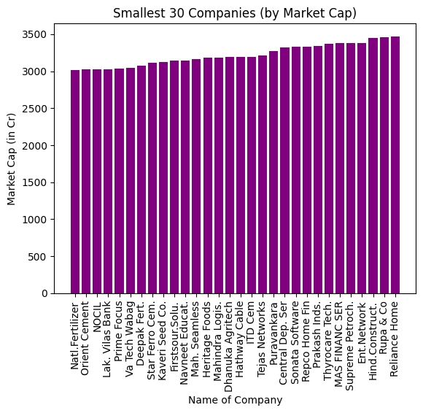
Top 30 Companies by Market Cap
Reliance Industries leads with the highest market cap.
Bottom 30 Companies by Market Cap
Natl. Fertilizers has the smallest market cap among the companies analyzed.

Slide 5
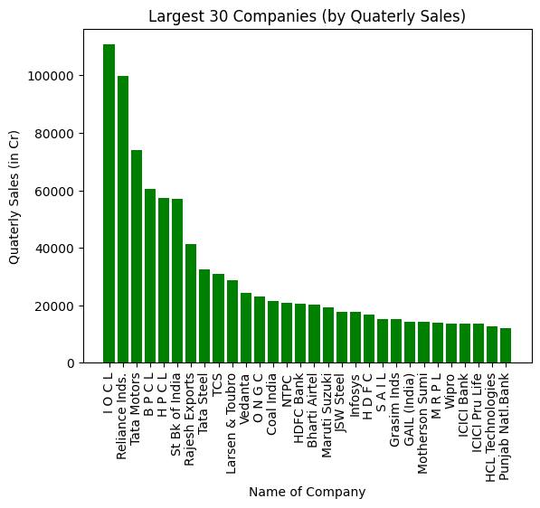
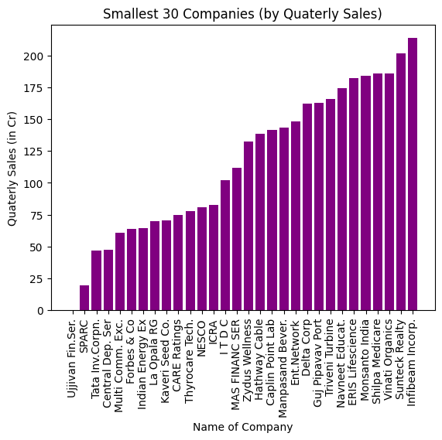
Top 30 Companies by Quarterly Sales
IOCL stands out with the highest quarterly sales.
Bottom 30 Companies by Quarterly Sales
Ujjivan Financial Services recorded no quarterly sales, indicating financial struggles.

Slide 6
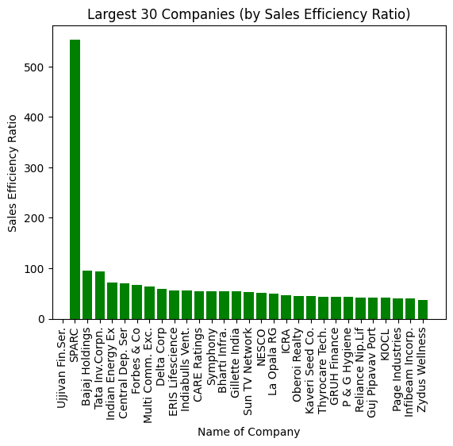
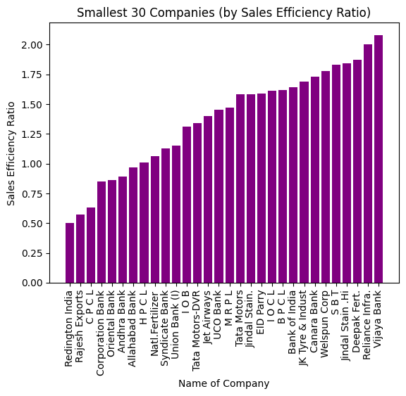
Sales Efficiency Ratio
SPARC has the highest Sales Efficiency Ratio, indicating strong sales efficiency.
Ujjivan Financial Services has the lowest, reflecting inefficiency.

Slide 7
Insights
Reliance Industries (5,83,436 Cr) has the biggest market cap share
Conclusion
Reliance Industries stands out with the largest market capitalization, while Ujjivan Financial Services appears to be struggling with both low quarterly sales and low sales efficiency
Recommendation
For Investors: Consider investing in companies with strong market caps and sales efficiency.
Natl. Fertilizers (3,017 Cr) has the smallest market share
IOCL (1,10,666 Cr) has most quarterly sales
Ujjivan Financial Services (0 Cr) has least quarterly sales
SPARC (553.82) has the highest Sales Efficiency Ratio
Ujjivan Financial Services (0.0) has the lowest sales Sales Efficiency Ratio
majority companies market cap lies between between 0 - 1,50,000 Cr
Majority companies quarterly sales lies between 0 - 27,500 Cr
The majority of companies fall within certain ranges of market capitalization and quarterly sales, indicating the typical distribution in the market
For Companies: Focus on improving sales efficiency to boost market cap and address areas of underperformance, particularly in sales.

Slide 8


